Slide 1
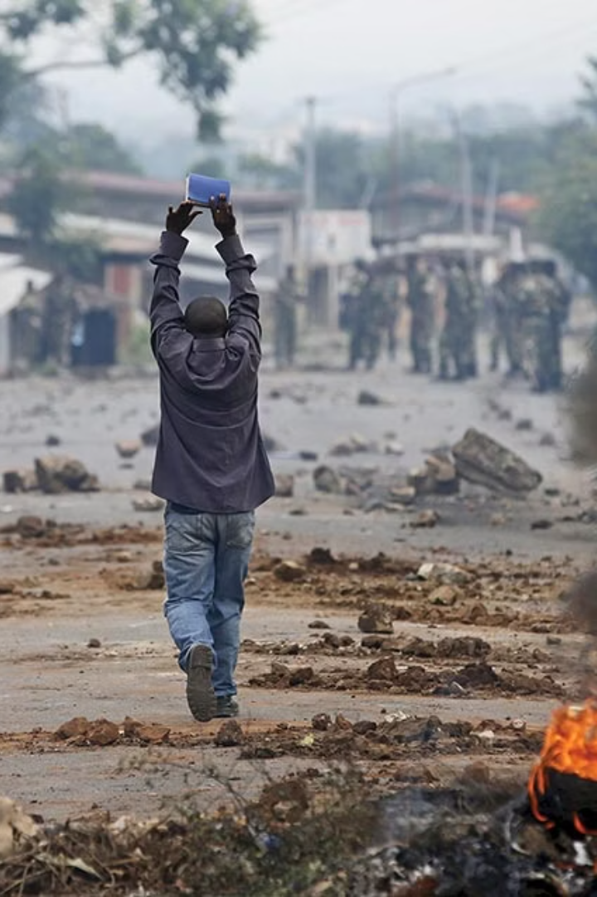
Analyzing Africa's Conflict Landscape
Informing business investments through conflict analysis. Africa presents vast opportunities but also faces political instability.
Date: 1 April 2025
By: Group 11

Slide 2





Our Team – Group 11
Kelvin Njenga- Data Scientist
Colleta Kiilu- Data Scientist
Josphat Wanjiru- Data Scientist
Nicholas Miencha- Data Scientist
Monica Wanjiru- Data Scientist

Slide 3
Overview
Business and Conflict Analysis
Data-Driven Insights
Modelling and
Deployment
Leveraging data cleaning and visualisation techniques to get geographical insights.
Understanding the intersection of business investments and conflict zones in Africa.
Applying predictive modelling for informed decision-making and risk mitigation.

Slide 4
Business Understanding
1
Market Entry
2
Risk
3
Opportunity
Understand the local market dynamics before investing.
Assess potential risks to ensure safe operations. Political instability can threaten investments.
Identify new opportunities for investment. Emerging markets offer high growth.

Slide 5

Problem Statement
1
Multinational Client
2
Data Analysis
3
Risk Assessment
VMagic Leather, a multinational corporation, is looking to establish a new manufacturing plant in Africa. They require a location that offers long-term stability and minimal risk to their investment and operations.
Extensive data analysis is required to pinpoint potential conflict hotspots across the continent. The analysis should also aim to forecast future events that could impact the stability of various regions, enabling proactive decision-making.
A comprehensive risk assessment model needs to be developed to evaluate the risks associated with different locations. This model will guide VMagic Leather's investment decisions by providing a clear understanding of potential challenges and opportunities.

Slide 6
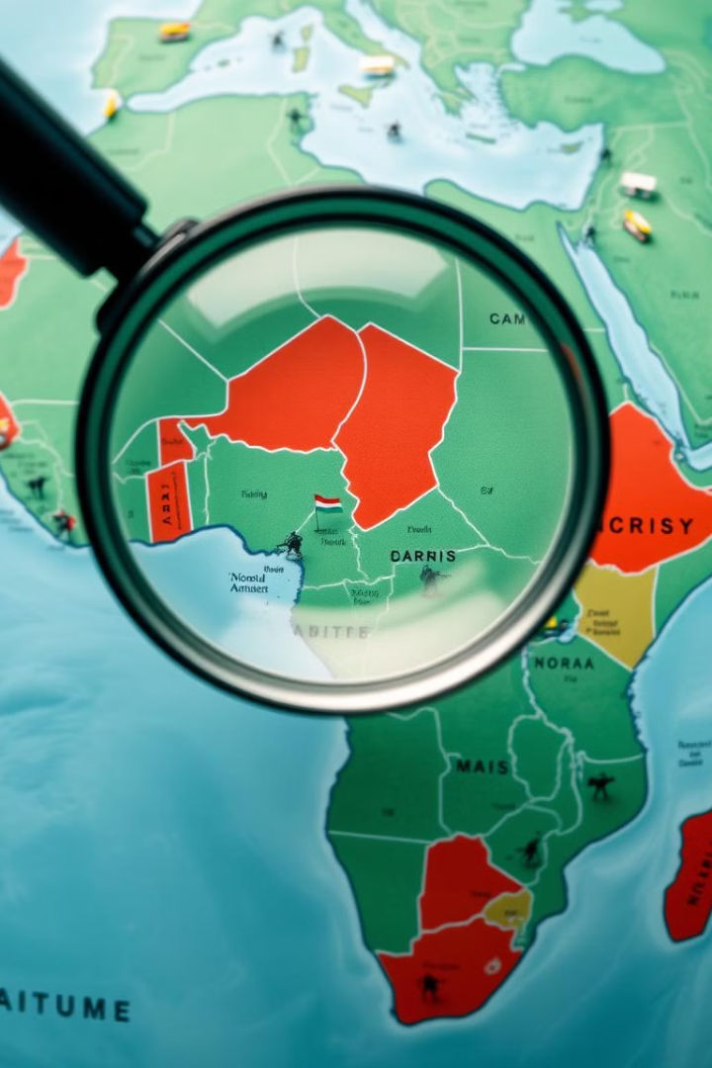
Objectives
Dataset Exploration
Statistical and Predictive Analysis
Explore the dataset to gain familiarity with its structure, terminology, and quality by examining key variables, including numerical and categorical data.
Perform statistical and exploratory data analysis that includes correlation analysis, hypothesis testing, predictive modelling, and descriptive and exploratory analysis utilizing statistical measures
Conflict Analysis
Map and Identification
Conduct a comprehensive conflict analysis in Africa by establishing a foundational understanding of conflict types, high-risk regions, and underlying causes
Map and identify high-risk nations and areas to enhance early warning systems through geographic risk assessments.
Business Insights
Provide business insights for a multinational client to help identify conflict-free locations for a manufacturing facility by developing a predictive model to forecast conflict occurrences based on historical data

Slide 7




Data Understanding
ACLED Dataset
Global Network
Comprehensive
Real-time data on political violence and protests. The source of the data is http://acleddata.com/about-acled/
Aggregates reports from local and regional media.
Includes event details and contextual attributes.
The dataset contains 413,948 rows and 31 features, updated weekly.

Slide 8





Data Cleaning
Removed Irrelevant Columns
Dropped columns such as event_id_cnty, timestamp, notes, source, and tags to streamline the dataset and improve processing efficiency.
Redundancy
Eliminated redundant features like duplicated date entries and non-predictive columns to reduce noise and prevent multicollinearity in the model.
Focus
Concentrated on key variables, including event type, location, fatalities, and actor details, to ensure the analysis remains targeted and relevant.
Handled Missing Values
Imputed or removed missing values in critical columns to avoid biases and errors during the modeling phase, ensuring data integrity.

Slide 9



Data Visualization
Actors & Interactions
Key actors involved include Al-Shabaab, protesters, state forces, and various rebel groups. Interactions range from direct combat to protests and government responses.
2
Event Characteristics
Political violence, including battles and explosions, constitutes a significant portion of the events. Demonstrations and protests also play a crucial role in the conflict landscape.
1
Geographic Distribution
Eastern Africa, particularly Somalia, and Nigeria are the most affected regions. Other areas with notable conflict occurrences include the Sahel region and parts of Central Africa.
3

Slide 10
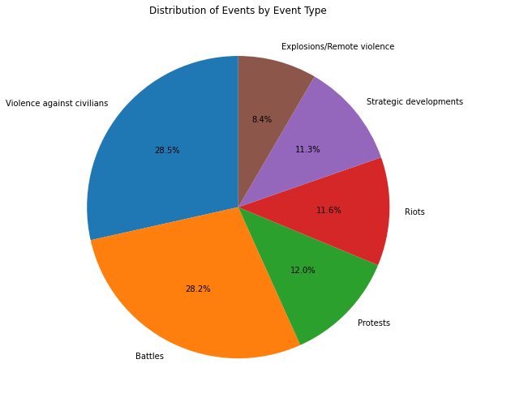
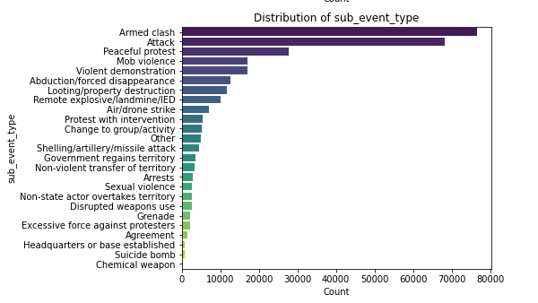
Distribution of Event Characteristics

Slide 11
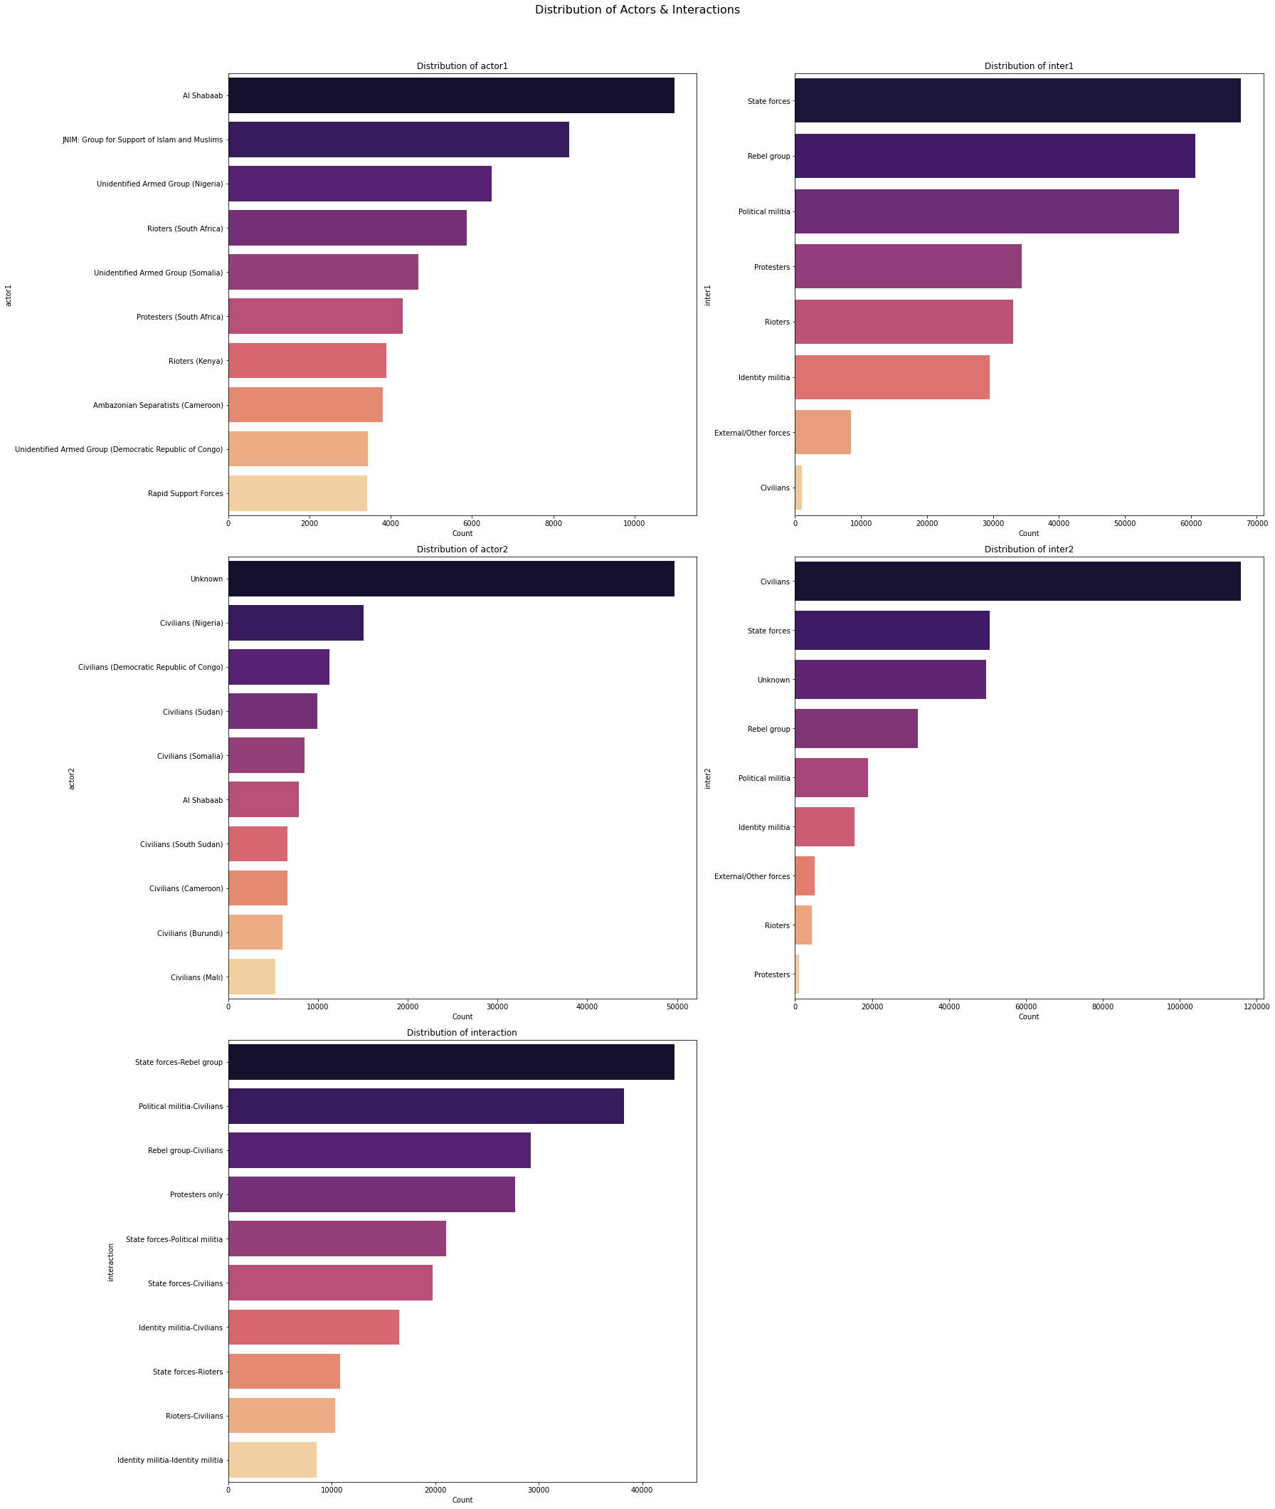
Distribution of Actors and Interactions

Slide 12
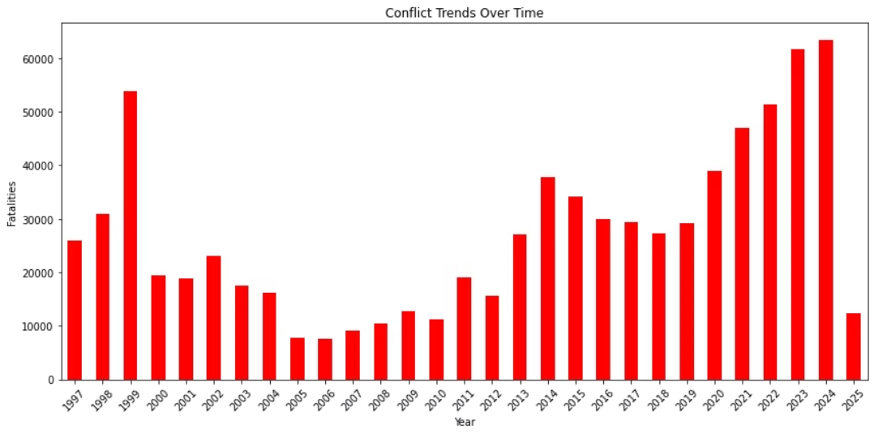
Conflict Trends Over Time
We can see that starting from the graph , there was a noticeable increase in conflict events in 2019 and 2020, potentially signaling escalating tensions or changes in the geopolitical environment. It is crucial for stakeholders to closely monitor these trends and adapt strategies accordingly to promote peace and stability in these regions.

Slide 13
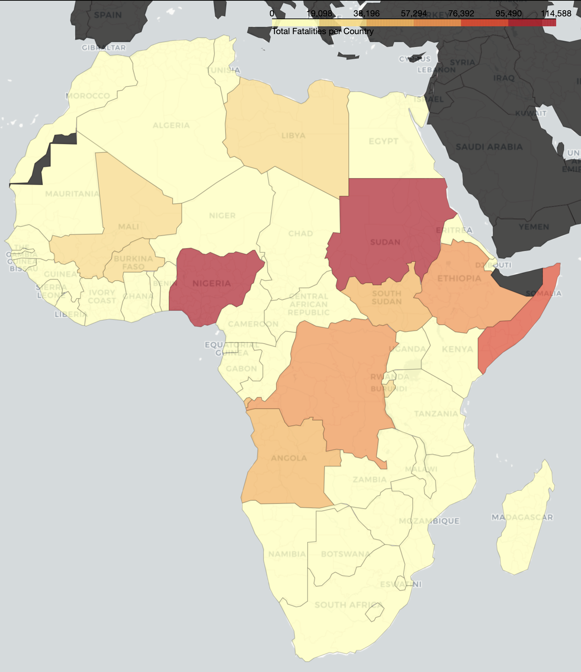
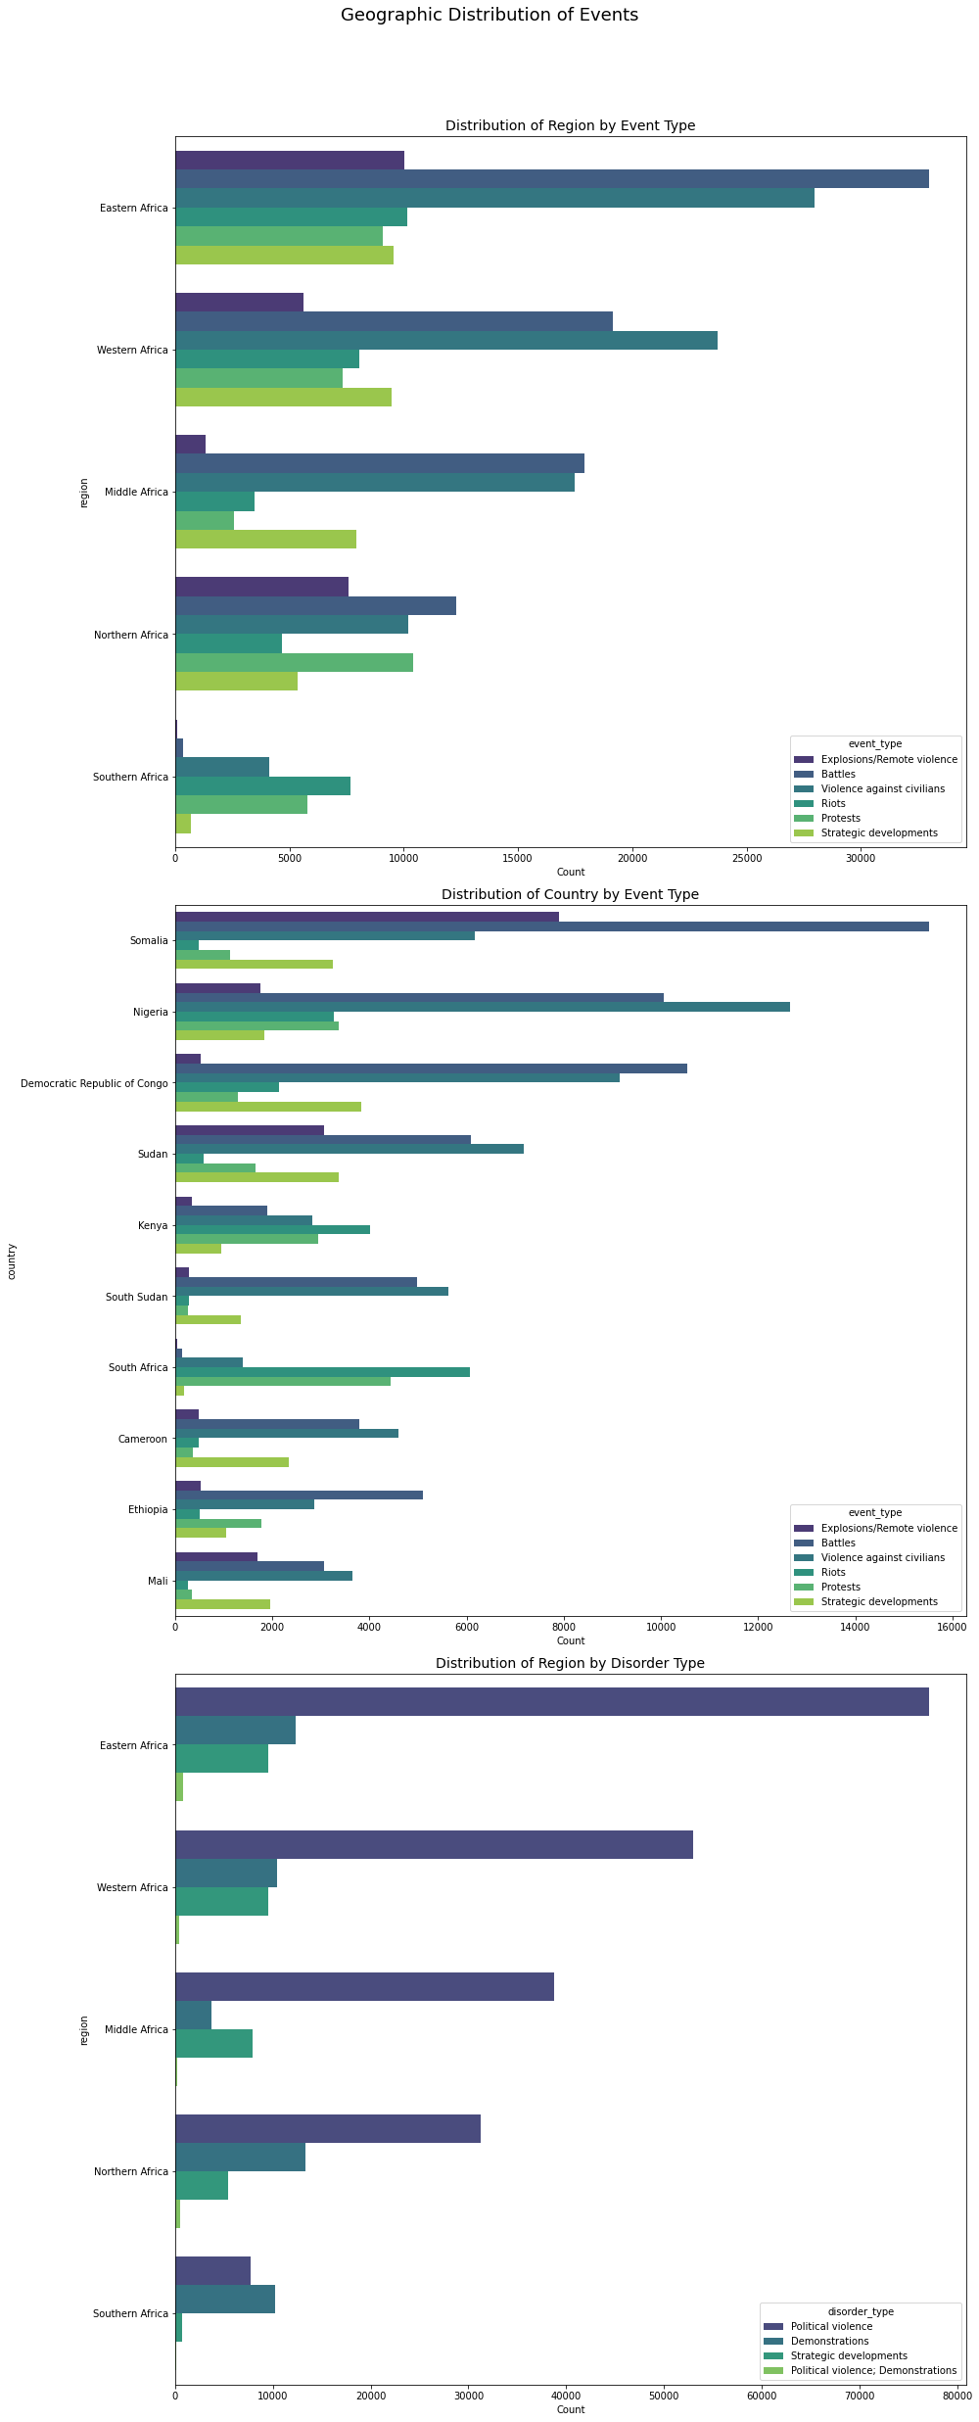



Geographic Distribution of Conflict Zones
Eastern Africa
Experiences frequent political violence and demonstrations, often triggered by political instability, ethnic tensions, and resource scarcity. The region is a hotspot for both state and non-state actors, leading to complex and prolonged conflicts.
Somalia
Identified as a high-risk area with active conflict events, including clashes between Al-Shabaab and government forces. The ongoing humanitarian crisis and weak governance structures exacerbate the situation.
These regions are identified as the most affected areas, experiencing frequent political violence and demonstrations, with active involvement of groups like Al-Shabaab and state forces. The convergence of political, economic, and social factors in these areas has created a volatile environment, requiring targeted interventions to address the root causes of conflict and promote sustainable peace.
This map illustrates the concentration of conflict events across Africa. Key areas of concern include Eastern Africa, particularly Somalia, and Nigeria, along with the Sahel region and parts of Central Africa. The varying intensities of color indicate the frequency and severity of conflict incidents within each region.
Nigeria
Faces political instability and demonstrations, impacting stability and economic development. Factors such as religious extremism, farmer-herder conflicts, and socio-economic inequalities contribute to the persistent unrest.

Slide 14
Modelling
XGBoost
1
Achieved an accuracy of 84.07% on the test dataset.
Demonstrated strong predictive power and robustness in handling complex relationships within the data.
Random Forest
Attained an accuracy of 83.93% on the test dataset.
2
Showed good performance and ability to generalize well across different subsets of the data.
Logistic Regression
Obtained an accuracy of 80.71% on the test dataset.
3
Provided a solid baseline performance with relatively simple and interpretable modeling approach.

Slide 15
Conclusion
Our conflict prediction model, leveraging XGBoost, achieved 84.07% accuracy. This strong predictive performance demonstrates its ability to classify conflict types based on historical data. The model can reliably identify patterns and relationships, making it a valuable tool for anticipating potential conflicts and enabling proactive decision-making.

Slide 16

Recommendations
84%
1
Accuracy
Risk Mitigation
The XGBoost model achieved a high accuracy rate of 84.07% in predicting conflict. This allows for reliable identification of potential conflict zones.
To minimize potential losses, it is advisable to avoid investing in areas identified as high-risk by the model. Consider delaying investments until stability improves.
2
3
Resource Allocation
Early Warning System for Crisis Management
Prioritize allocating resources to regions identified as safer and more stable by the model. This strategic allocation can lead to more sustainable and profitable ventures.
Implement an early warning system that leverages the model's predictive capabilities to detect potential crises. This will enable rapid response, preventing financial losses and maintaining a competitive edge.

Slide 17
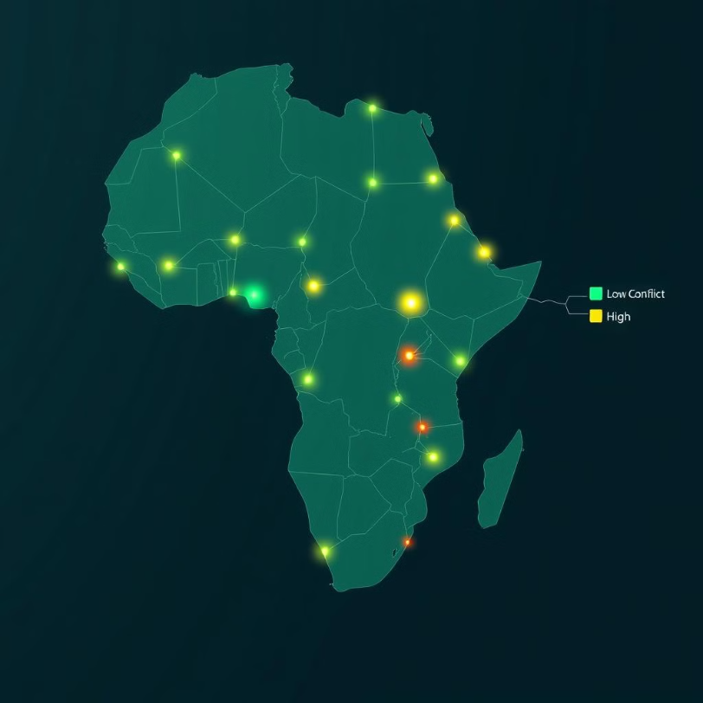
Deployment
The Africa conflict prediction system was deployed on render
From the interface the user is required to input and submit the region and the country
The output from the deployed web app is as follows:
Conflict risk levels
Probability of conflict
Type of conflict
Conflict Summary
Recommendation to the investor
To access the prediction service follow the link below:
​🔗Web_app link

Slide 18

Call to Action
Invest in Africa to unlock significant opportunities. Your investments drive sustainable growth and stability.
Supporting local economies creates jobs and fosters innovation. Together, we can build a prosperous future for Africa.
1
Economic Growth
2
Social Impact
Fuel Africa's expanding markets by investing in key sectors such as technology, infrastructure, and renewable energy, which are poised for exponential growth.
Drive positive change in communities by supporting education, healthcare, and sustainable agriculture initiatives that improve livelihoods and promote inclusive development.
3
High Returns
Benefit from emerging market potential by capitalizing on the increasing consumer base, resource-rich environment, and strategic location for global trade, offering substantial returns on investment.

Slide 19

Thank You
Thank you for considering our conflict analysis. We offer support for strategic investment decisions. This aims to mitigate risk and promote stability in Africa.
Our insights enable informed and responsible investments. Together, we can drive economic growth and foster lasting peace. This will create a prosperous future for all.

